Slide 1
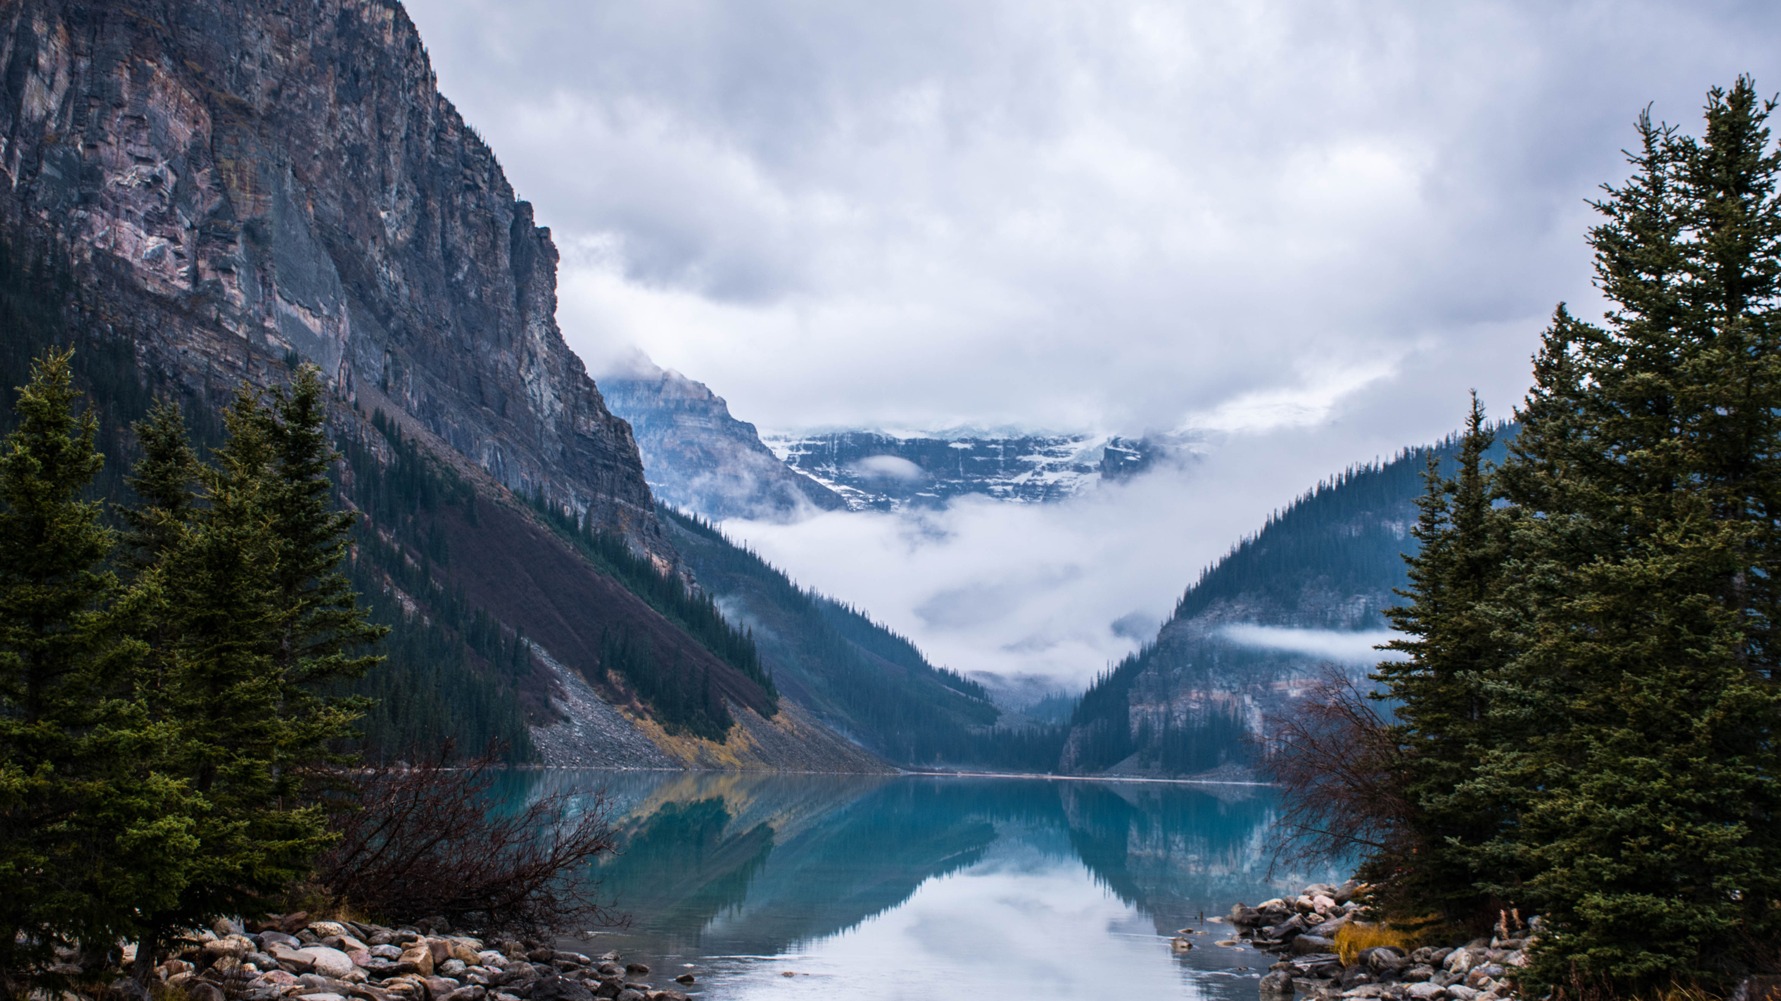


Data to the Rescue:
Visualizing water quality in your community!

Slide 2

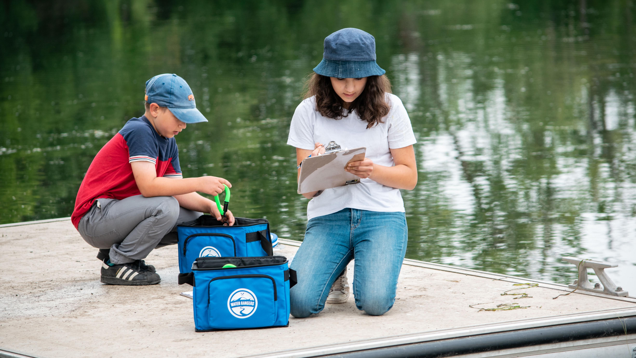
Part 1
How is water affected by human activity?

Slide 3
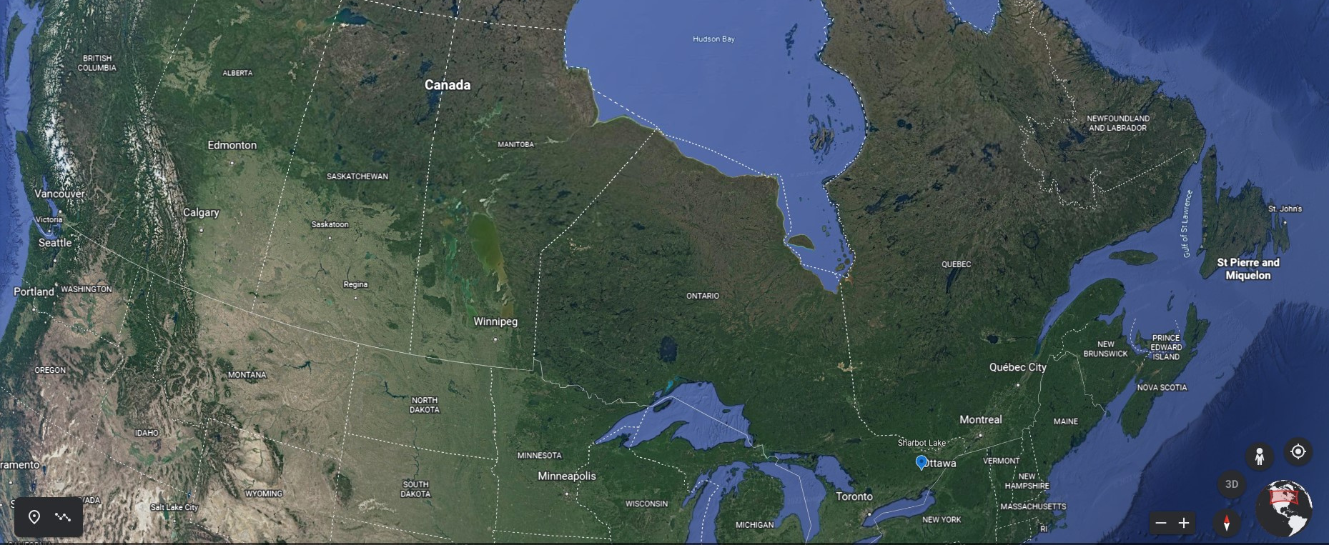

Part 1: Introducing Sharbot Lake
Notes:
“Sharbot Lake is a lake in eastern Ontario, an hour and a half from Ottawa, and one hour from Kingston. The lake was named after Francis Shabot, who was an Algonquin Indigenous chief (Shabot Obaadjiwan) in the 1800s”.

Slide 4
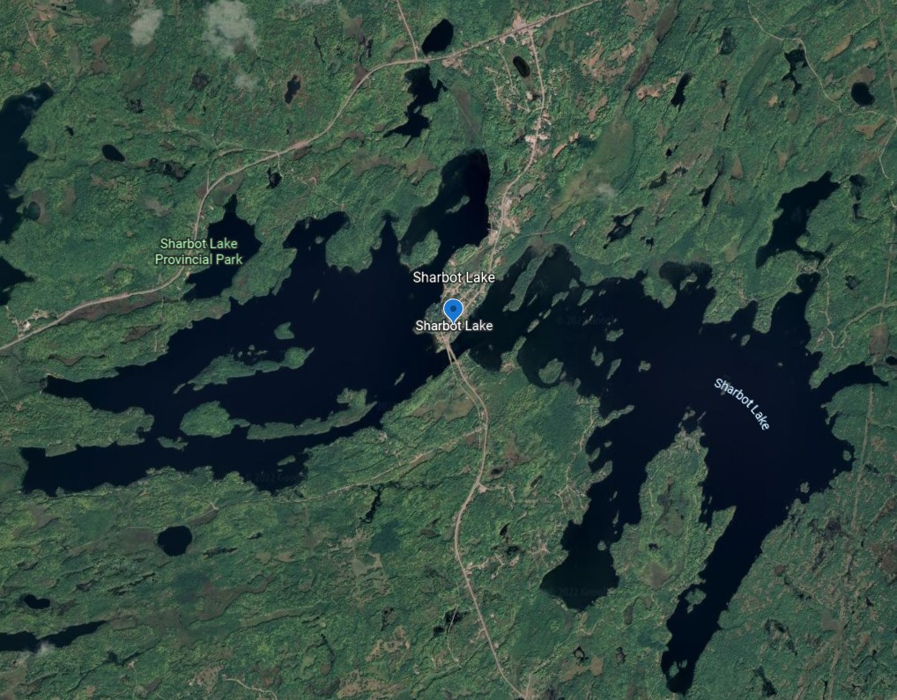
Part 1: Introducing Sharbot Lake

Slide 5

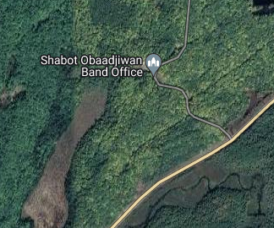
Part 1: Introducing Sharbot Lake
Notes:
“Many small communities use the lake for different purposes. Today we will be talking about three of those communities”.

Slide 6
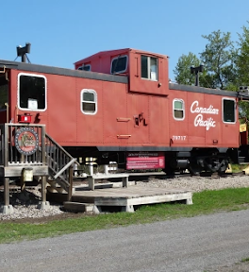
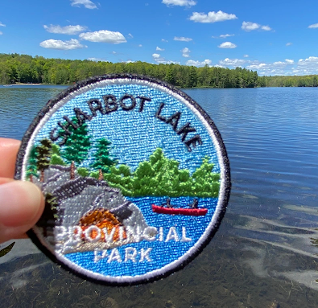
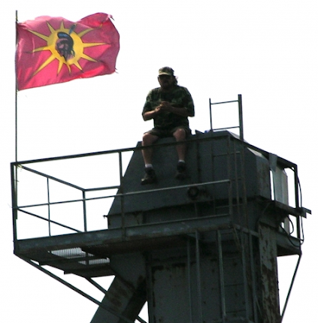
Part 1: Introducing Sharbot Lake
The town of Sharbot Lake
Sharbot Lake Provincial Park
Shabot Obaadjiwan
Notes:
The town of Sharbot Lake was built around an old railway, and the cottagers use water for fishing and leisure.
The provincial park has been around since the 1950s, hosts campers, and helps with protection and conservation of land.
Shabot Obaadjiwan, part of the Algonquin Nation, has been around since at least 3000 BCE. It successfully opposed a uranium mining venture in 2008.

Slide 7
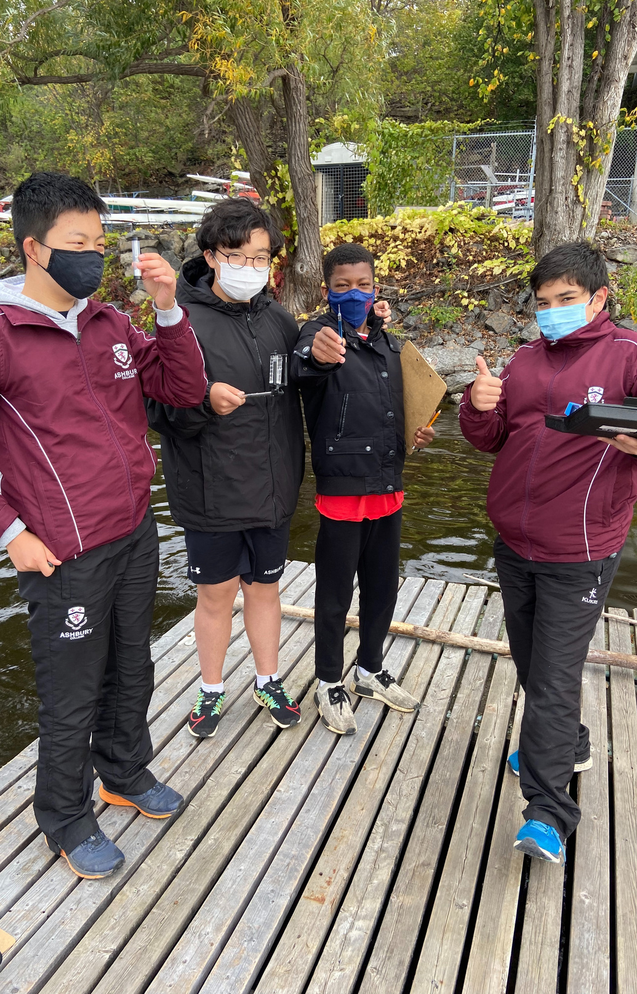
Part 1: Introducing Sharbot Lake
How could each community positively or negatively impact the health of Sharbot lake?
  How might the economic activity of the village affect the health of Sharbot lake?
  How might the presence of cottages around the lake affect the health of Sharbot lake?
  How can the Provincial Park staff protect Sharbot lake?
  How do you think uranium mines might have affected the health of Sharbot lake?

Slide 8
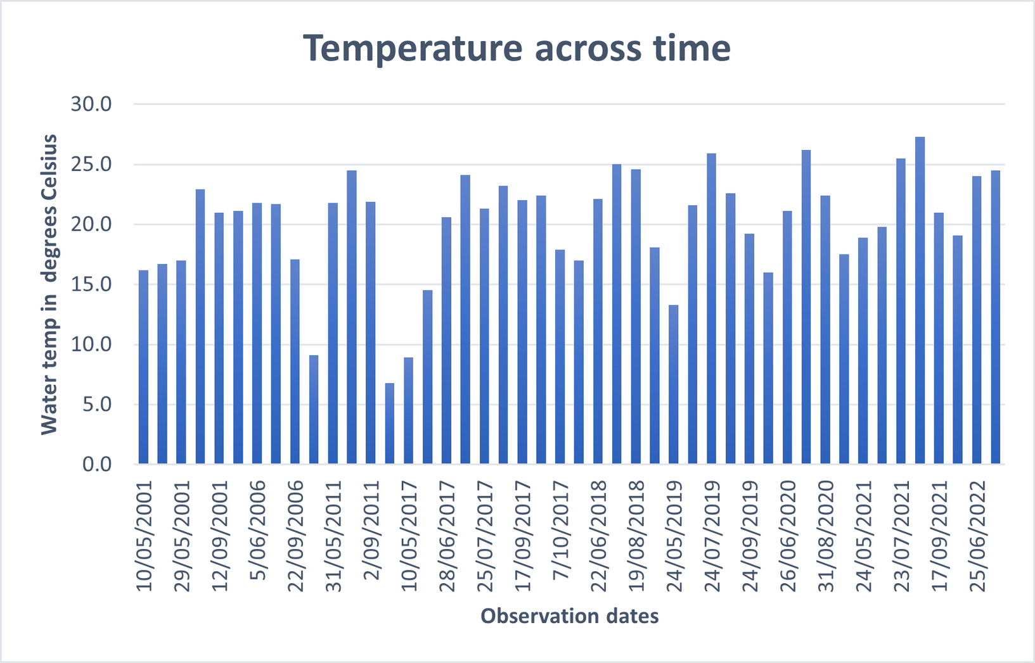
Part 1: Introducing Sharbot Lake
  What are some things you notice about the graph?
  What's something you're wondering about the data you see?
  What do you think the data may look like in 5 years? Why?

Slide 9
Part 1: Introducing Sharbot Lake
Extension activity:
  Looking at the graph, do you notice any trends (i.e., change over time)?
  What factors may have affected the temperature of Sharbot Lake since 2001?

Slide 10
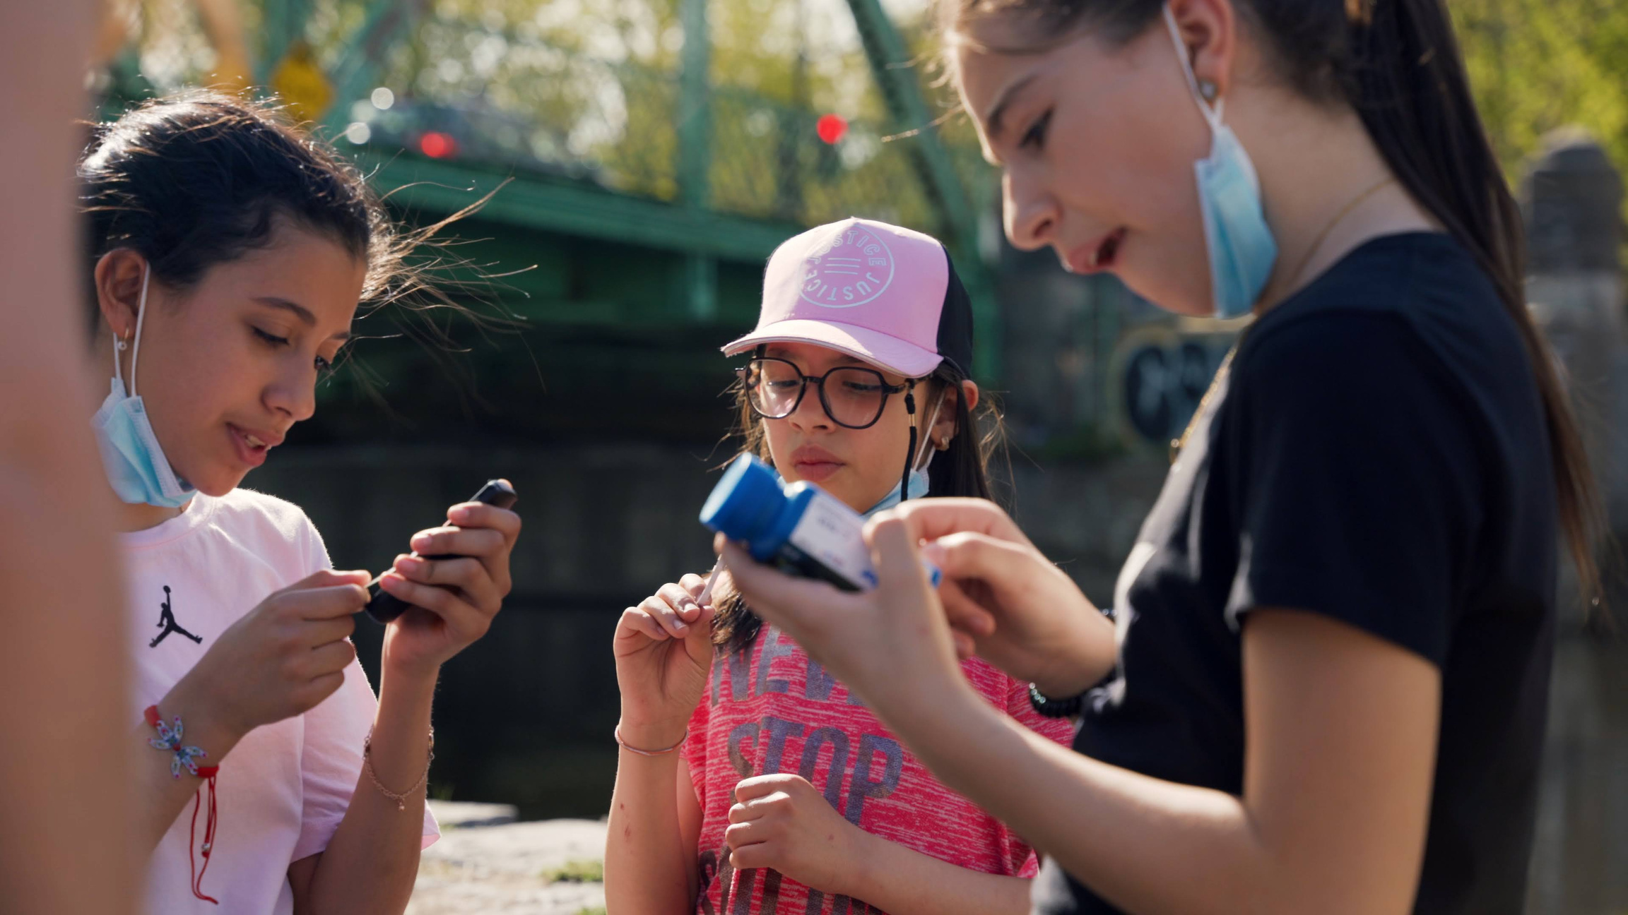
Part 2
How can we describe data by using statistics like mean and range?

Slide 11
Part 2: Describing data with statistics
  How can we learn more about the temperature of Sharbot Lake?
  What is the time range of the data?
  How many observations are there?
Notes:
“Today we will be using water quality data to see how Sharbot Lake has changed over time”. Show students the temperature bar graph from yesterday, again (refer to the slides for day
Ask class verbally:
How can we learn more details about the temperature of Sharbot Lake?
What is the time range of the data?
How many observations are there?

Slide 12
Part 2: Describing data with statistics
Grades 4-6: Looking at the tables on the next slide, calculate :
  (GROUP 1) The MEAN of the data from 2001 to 2011.
  (GROUP 2) The MEAN of the data from 2017 to 2018.
  (GROUP 3) The MEAN of the data from 2019 to 2022.
(To simplify calculations, you can round table values to the nearest whole number.)
Grades 6-8: Looking at the tables on the next slide, calculate:
  (GROUP 1) The RANGE of the data from 2001 to 2011.
  (GROUP 2) The RANGE of the data from 2017 to 2018.
  (GROUP 3) The RANGE of the data from 2019 to 2022.

Slide 13
Part 2: Describing data with statistics
Table 3: Temp. °C 2019-2022
Table 1: Temp. °C 2001-2011
Table 2: Temp. °C 2017-2018
Observation date | Water temp.
5/24/2019 | 13.3
6/24/2019 | 21.6
7/24/2019 | 25.9
8/25/2019 | 22.6
9/24/2019 | 19.2
5/24/2020 | 16.0
6/26/2020 | 21.1
7/26/2020 | 26.2
8/31/2020 | 22.4
9/26/2020 | 17.5
5/24/2021 | 18.9
6/27/2021 | 19.8
7/23/2021 | 25.5
8/20/2021 | 27.3
9/17/2021 | 21.0
5/29/2022 | 19.1
6/25/2022 | 24.0
7/31/2022 | 24.5
Observation date | Water temp.
5/10/2001 | 16.2
5/17/2001 | 16.7
5/29/2001 | 17.0
8/22/2001 | 22.9
9/12/2001 | 21.0
6/1/2006 | 21.1
6/5/2006 | 21.8
8/25/2006 | 21.7
9/22/2006 | 17.1
10/27/2006 | 9.1
5/31/2011 | 21.8
8/4/2011 | 24.5
9/2/2011 | 21.9
Observation date | Water temp.
4/28/2017 | 6.8
5/10/2017 | 8.9
5/22/2017 | 14.5
6/28/2017 | 20.6
7/19/2017 | 24.1
7/25/2017 | 21.3
8/17/2017 | 23.2
9/17/2017 | 22.0
9/20/2017 | 22.4
10/7/2017 | 17.9
5/23/2018 | 17.0
6/22/2018 | 22.1
7/27/2018 | 25.0
8/19/2018 | 24.6
9/27/2018 | 18.1
Notes:
Table 2 contains more observations than Table 1, and Table 3 more observations than either table, so you can ask your stronger students to work on Table 2 or 3.

Slide 14
Part 2: Describing data with statistics
Extension activity:
  Do you notice any outliers (data points that are very different from the others) in the tables or the graph? What may have caused them?
  How would the mean change if we removed these outliers?
  How would the range change if we removed these outliers?
Notes:
Extension: students will need to be onboarded with knowledge about outliers.

Slide 15
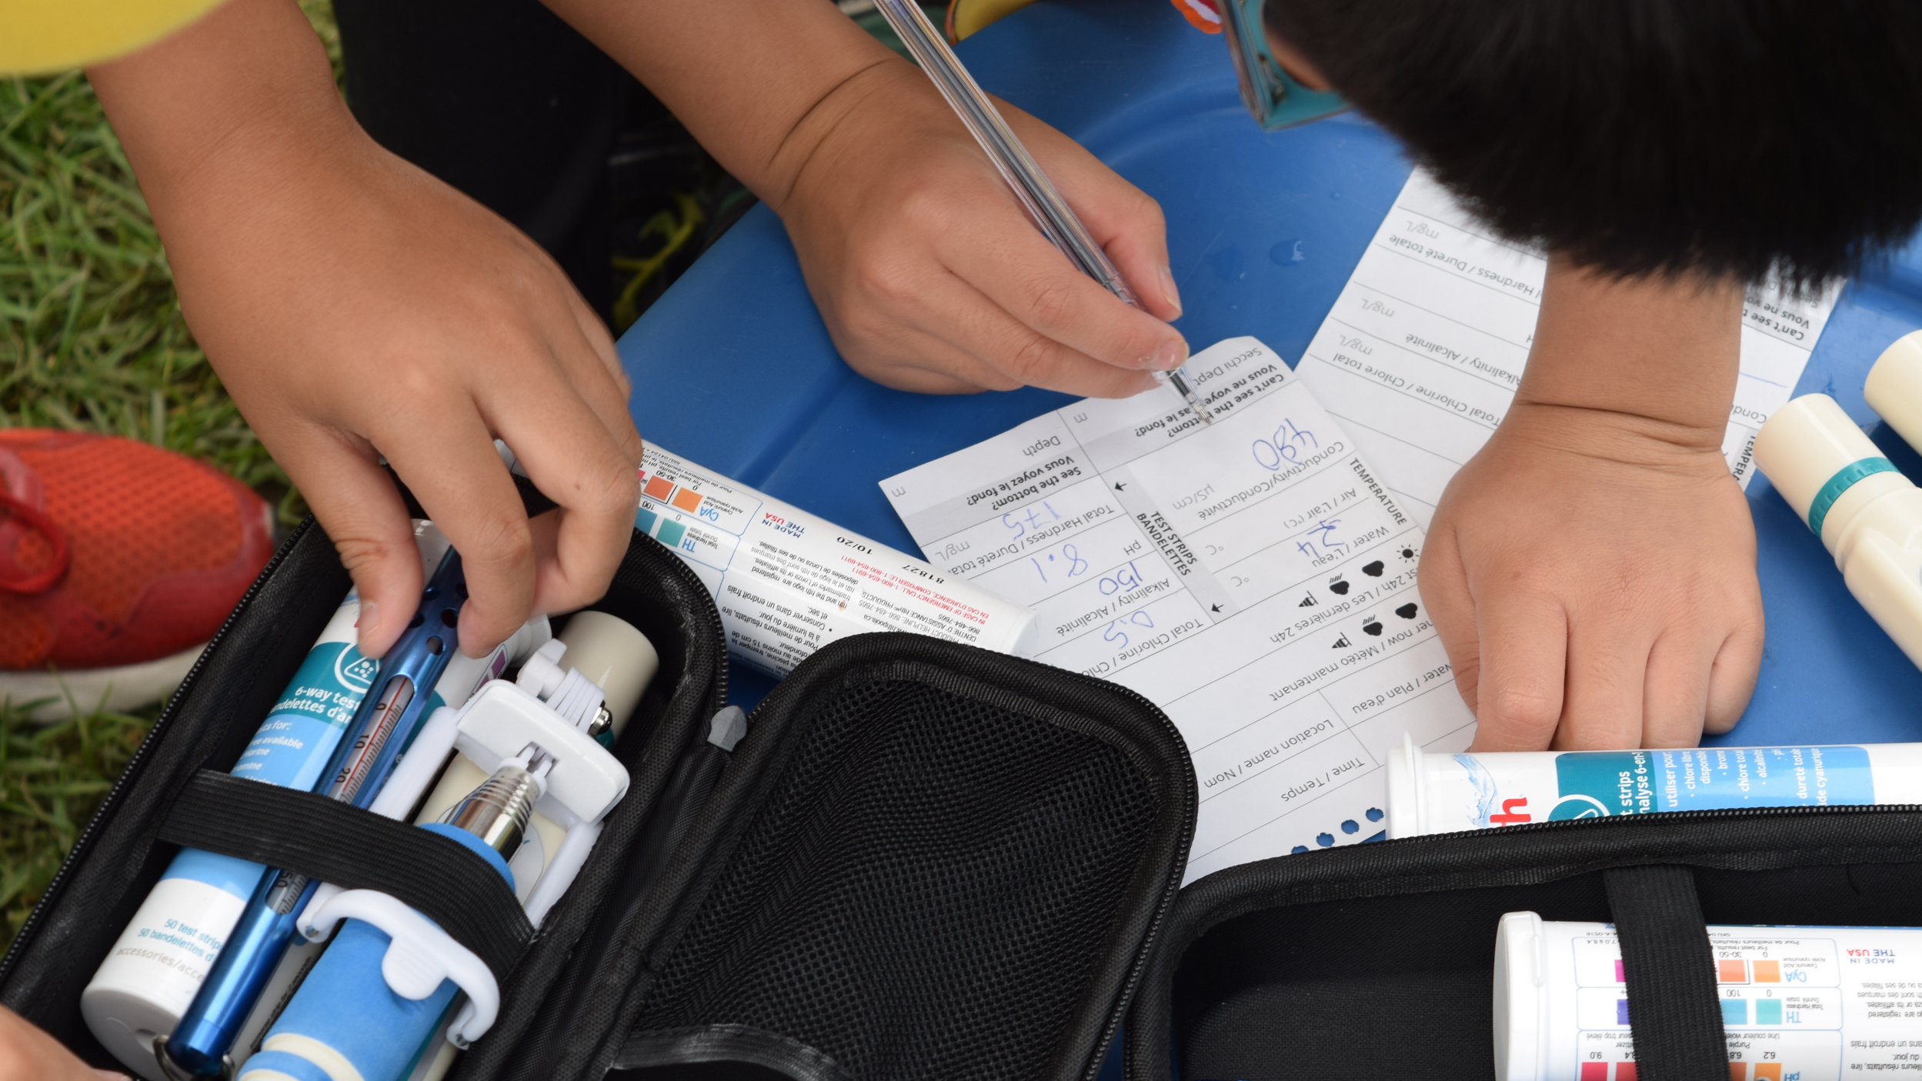
Part 3
How can we visualize changes over time in data?

Slide 16
Part 3: Interpreting graphs and trend lines
  From 2001-2011, the mean (average value) of the water temperature at Sharbot Lake was: 19.4 degrees Celsius.
  From 2019-2022, the mean is now: 21.4 degrees Celsius.
  What is happening at Sharbot Lake?
Notes:
The goal for students is to notice the gradual warming of the waters of Sharbot lake over the last 20 years.
“Let’s explore a way that we can better see change over time in the temperature of Sharbot Lake”.

Slide 17
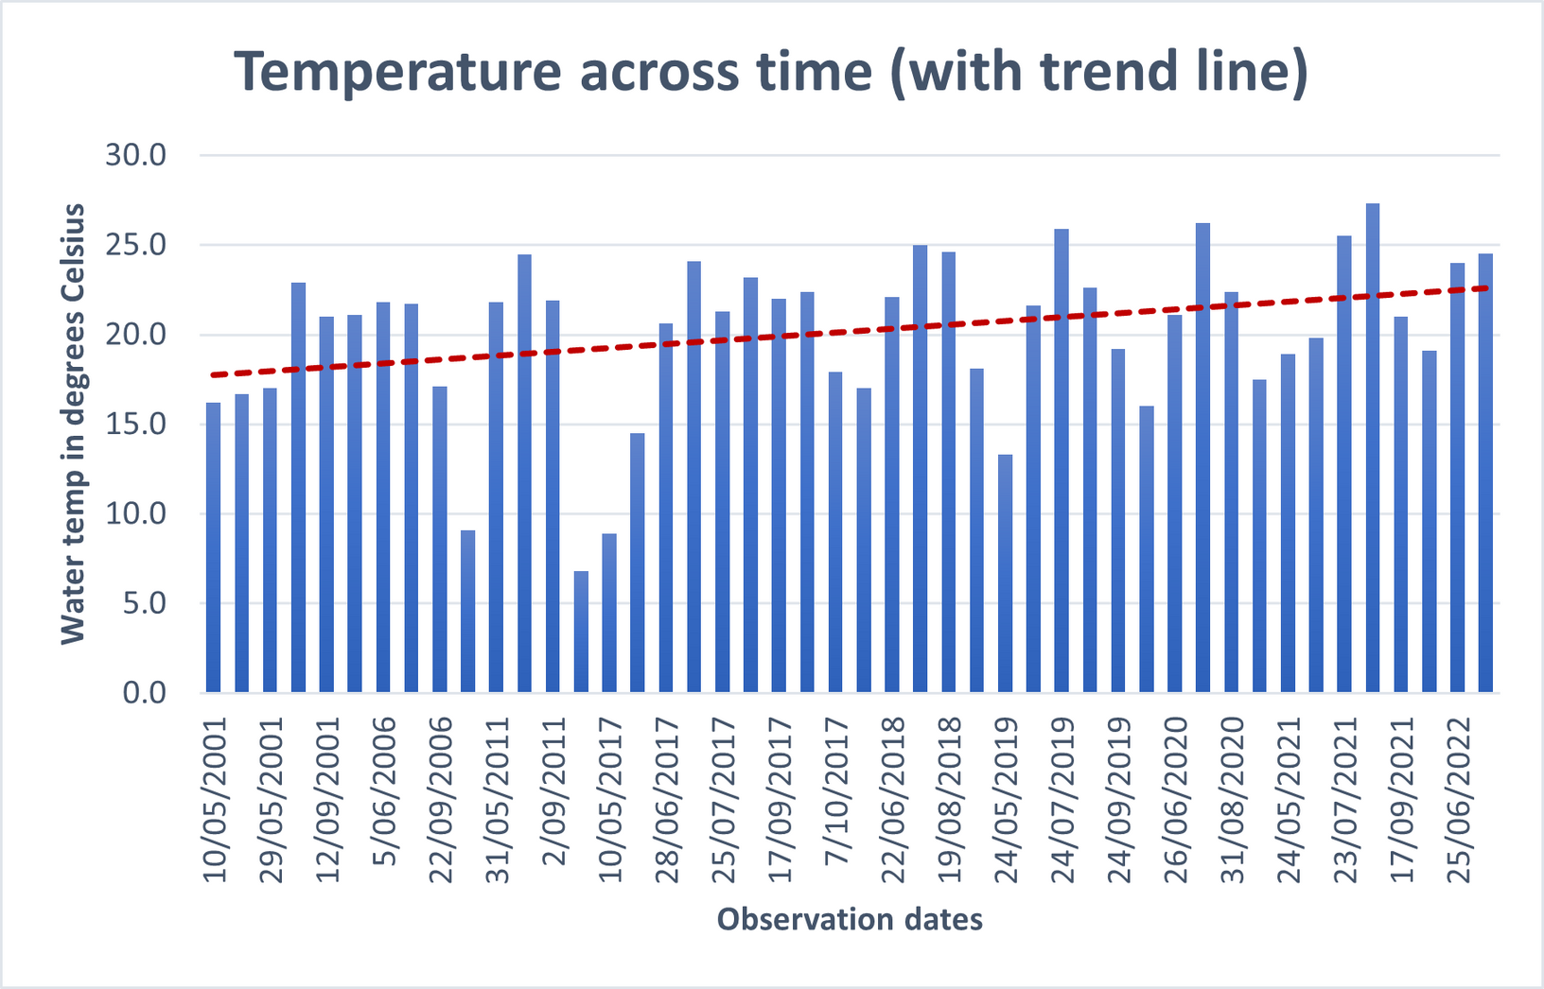
Part 3: Interpreting graphs and trend lines
  What do you see changing over time in the graph?
  What do you think the red line is showing?
  What can you see happening at Sharbot lake from 2001 to 2022?
  What do you think the consequences of this might be?
Notes:
The activity asks students to think about future consequences of gradual climate change. With time, explore causes and consequences of climate change within freshwater bodies. Perhaps loop back in prior knowledge students may have about climate change in previous grades. Connect climate change with local and national issues, such as mining, industrialization, and pollution.

Slide 18
Part 3: Interpreting graphs and trend lines
Extension activity:
  What can we learn from the trend line in the graph that we couldn’t learn from the bars?
  Given the trend line, what water temperature would you expect to observe in 1995? In 2030?
  How do you think outliers affect the trend line?
Notes:
The activity asks students to think about future consequences of gradual climate change. With time, explore causes and consequences of climate change within freshwater bodies. Perhaps loop back in prior knowledge students may have about climate change in previous grades. Connect climate change with local and national issues, such as mining, industrialization, and pollution.

Slide 19
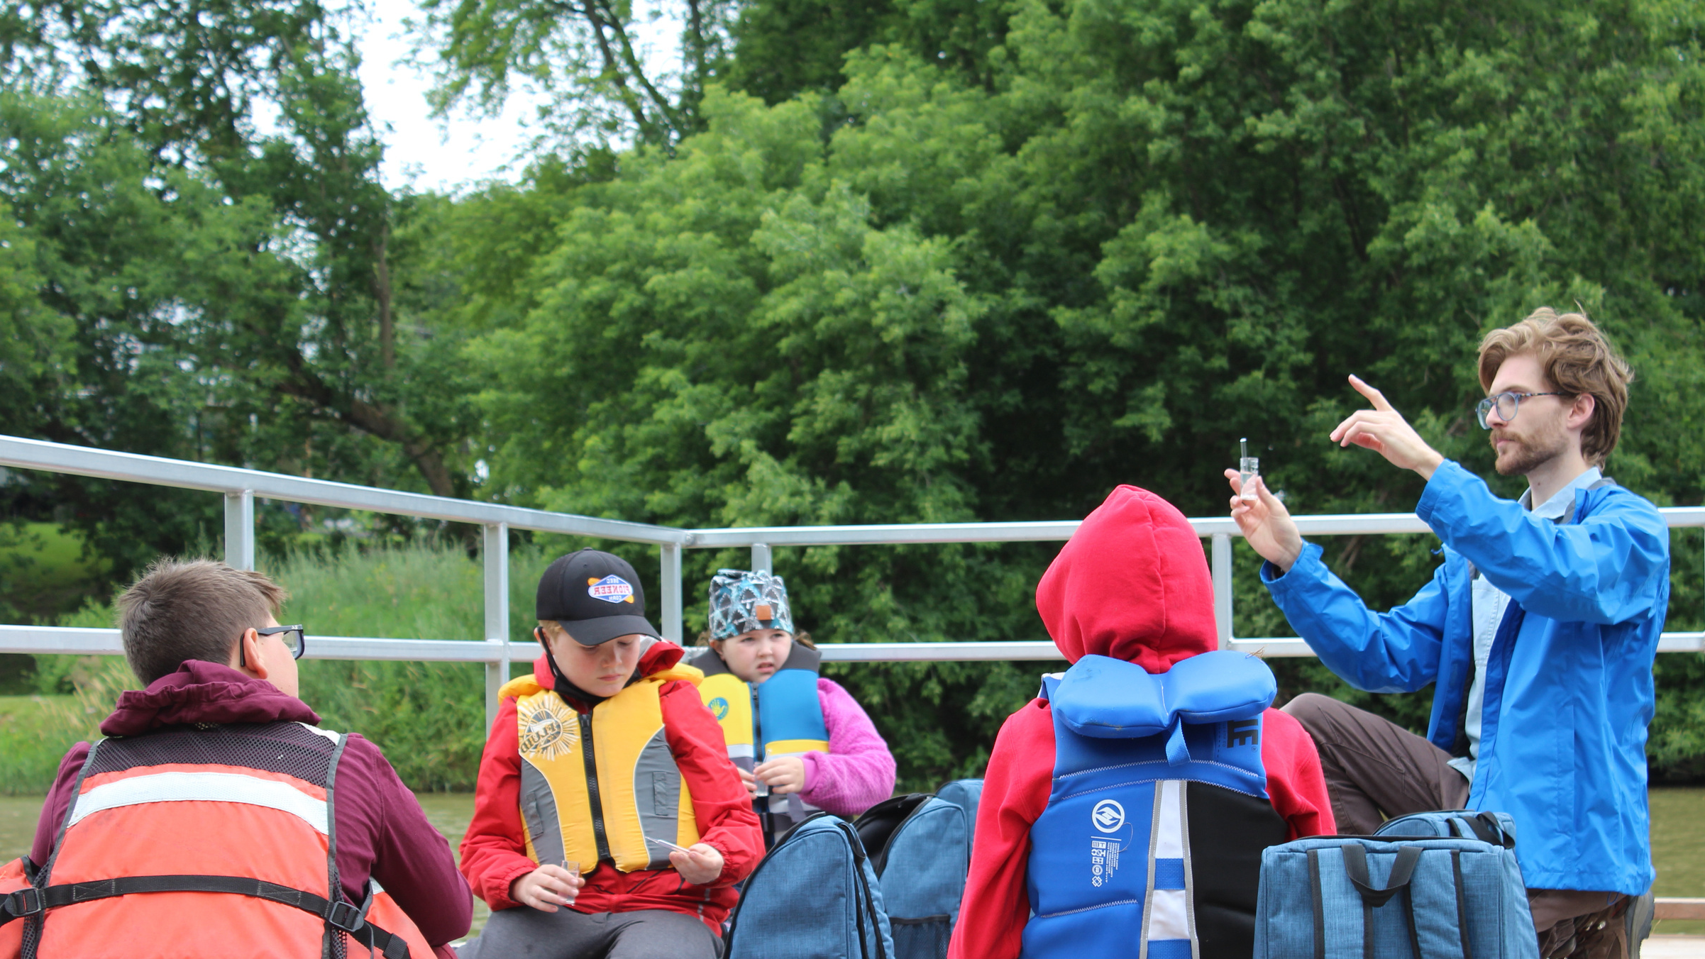
Part 4
What patterns can we see by comparing two sets of data?

Slide 20
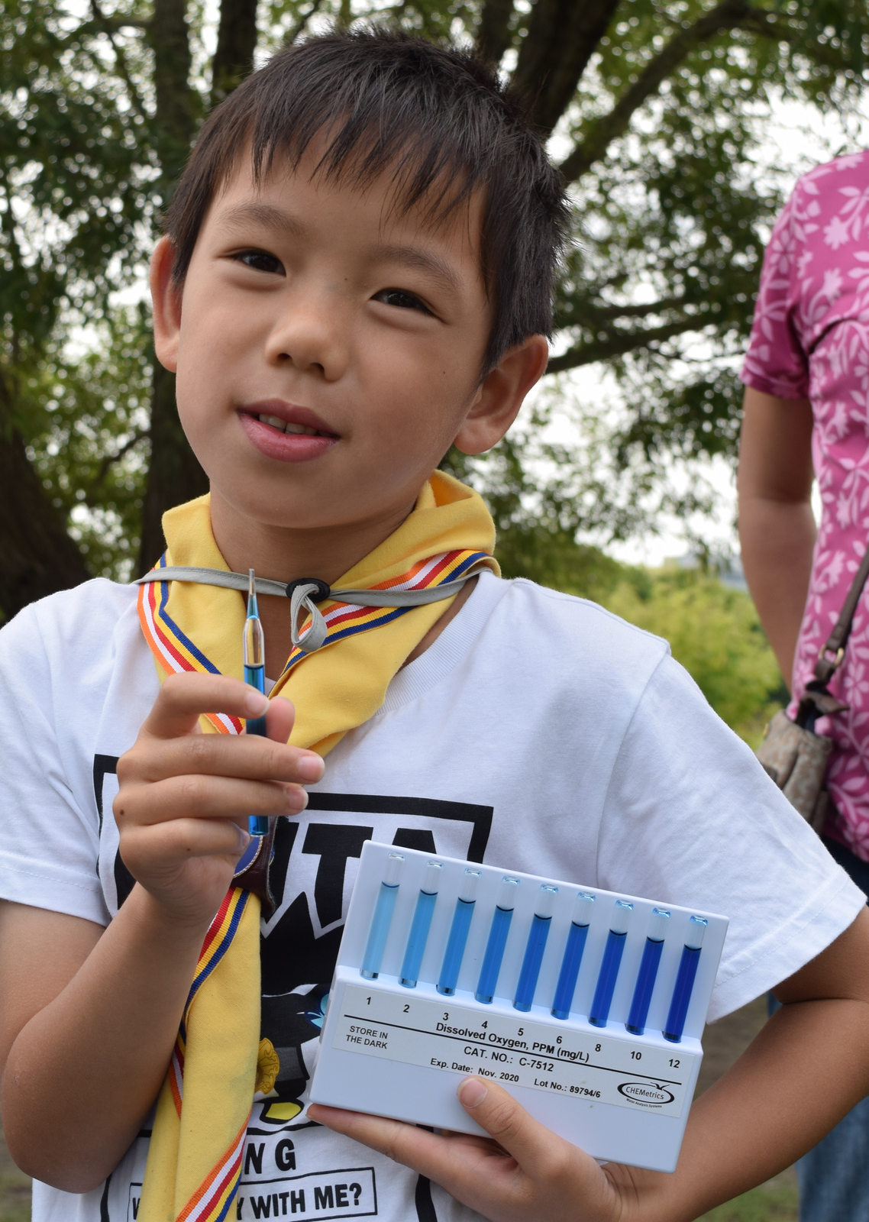
Part 4: Comparing two sets of data
Dissolved oxygen
What is it?
Dissolved oxygen is present in fresh and salt water. It's the amount of oxygen gas in the water. Dissolved oxygen is a minor component of a water solution. Oxygen gets into the water in various ways: it's absorbed from the atmosphere, by fast movement of the water like waves, or as a product of plant respiration (photosynthesis).
How is it measured?
The unit of measure for dissolved oxygen is milligrams per litre (mg/L). For example: If the dissolved oxygen level is 9mg/L, then in every litre of water, there will be 9 milligrams of oxygen.
Why does it matter?
Oxygen is what humans and animals breathe on Earth to survive! All living things need oxygen to survive, and many like fish and insects need dissolved oxygen to breathe in the water.
Notes:
“Today we are working with a new type of water quality parameter: dissolved oxygen”.
If students need additional understanding of dissolved oxygen, visit our page on it here: https://waterrangers.ca/testkits/tests/dissolved-oxygen/. Highlight that as dissolved oxygen drops, life in fresh water will struggle to cope. Fish spawn will be unsuccessful, competition for resources more difficult, and in extreme cases, fish and other animals will suffocate and die.

Slide 21
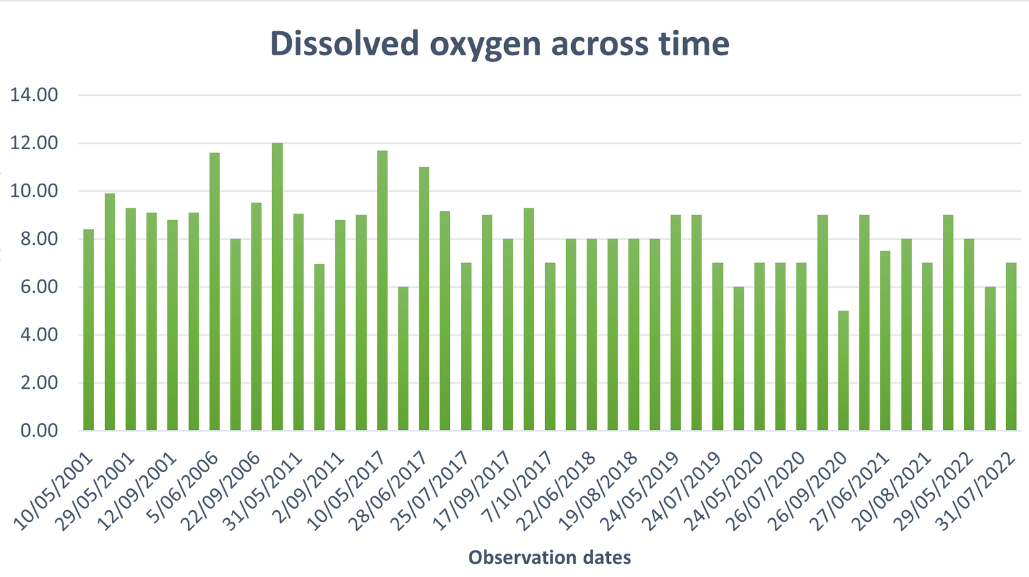
Part 4: Comparing two sets of data
  In the graph, when is the lowest recorded dissolved oxygen reading? When is the highest?
  What do you think will happen by the 2030’s?
  What is the lowest value that dissolved oxygen might reach?
  What might the consequences of this be for aquatic life?
Notes:
After hearing out and prompting for responses from students, have them write a few of their own answers, or their peers' answers down.

Slide 22
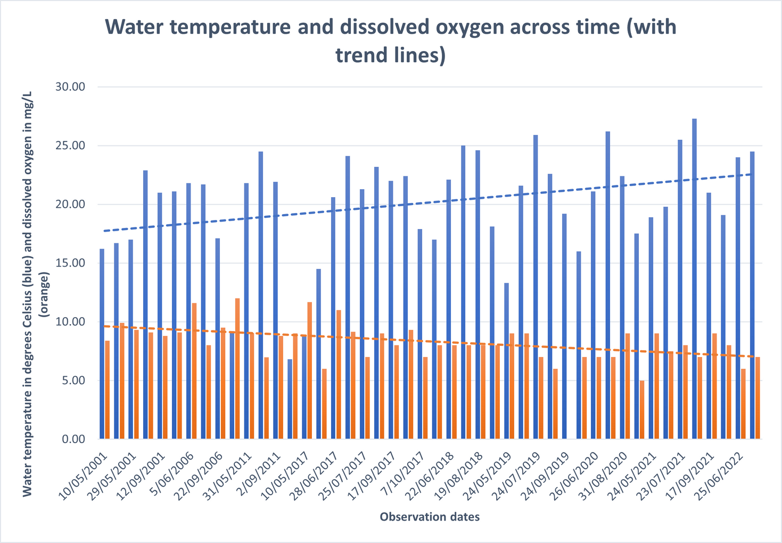
Part 4: Comparing two sets of data
  In the graph, how are water temperature and dissolved oxygen changing over time? Why do you think that might be?
  What does the graph suggest about the relationship between water temperature and dissolved oxygen? Do you think one may influence the other?
Notes:
You can explain that warmer water retains less oxygen (because warmer water molecules move faster, thereby letting oxygen escape). Warmer water can also lead to algal blooms, which in turn consume more oxygen.

Slide 23
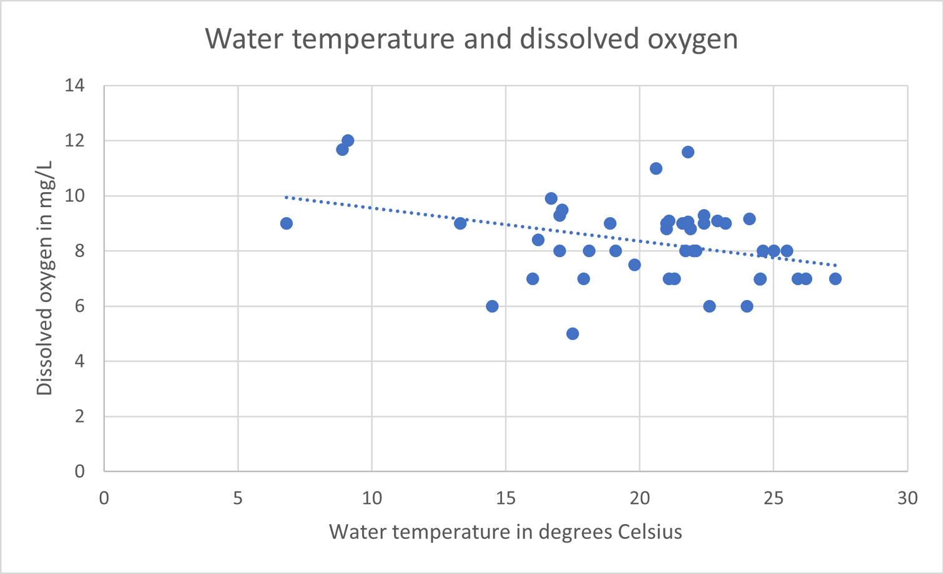
Part 4: Comparing two sets of data
Extension Activity:
  What is the highest value recorded for dissolved oxygen? What was the water temperature for this observation?
  What is the highest value recorded for water temperature? What was the value of dissolved oxygen for this observation?
  Based on the trend line (line of best fit), what dissolved oxygen value would you expect for a water temperature of 30 degrees Celsius?
  Based on the trend line (line of best fit), what water temperature would you expect for a dissolved oxygen value of 10 mg/L?
  What kind of relationship might exist between water temperature and dissolved oxygen?
Notes:
This activity involves interpreting a scatter plot, and is more complex than previous days. Leave the scatter plot up on the slides for students to work along with.
Encourage students who are new to these types of graphs to mark up their page and draw lines from the y-axis, horizontally out to the point using a ruler so that they can better see the values.

Slide 24
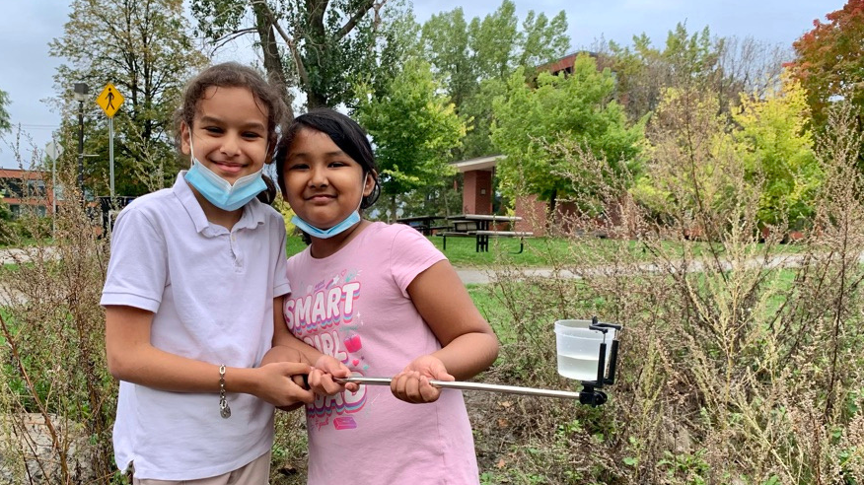
Part 5
What can we learn about displaying data by creating our own graph?

Slide 25
Part 5: Building our own graph
Table 1: Water temperature °C - East basin 2020-2022
Observation date | Water temperature
9/26/2020 | 17.4
4/25/2021 | 8.6
5/24/2021 | 19.9
6/27/2021 | 20.9
7/23/2021 | 25.8
8/20/2021 | 27.2
9/17/2021 | 20.7
4/24/2022 | 7.3
6/24/2022 | 24
7/30/2022 | 24.5
Based on the information in Table 1, make a bar graph using graph paper and a ruler. You need to choose what will go on the x and y axis, and to plot each bar correctly.
Remember to label your x and y axis, and include a title. To make it easier, you can round table values to the nearest whole number.
Notes:
“Today is the final day of our case study on Sharbot Lake”! To wrap up these activities, students will be creating a graph of water temperatures on Sharbot Lake’s east basin, given a set of values.
The goal of this activity is to help build student’s comfort with creating graphs, and to help them see the process that we must go through to make data easier to interpret.
If time requires, or if students would work well together, partner students up with their think-pair-share partners from yesterday. If possible, work with other grades on the extension activity at the same time, perhaps in a corner of the classroom.
Wrap up the session by gathering handouts and having students return to their desks. Ask students some final prompts about any visible trends.

Slide 26
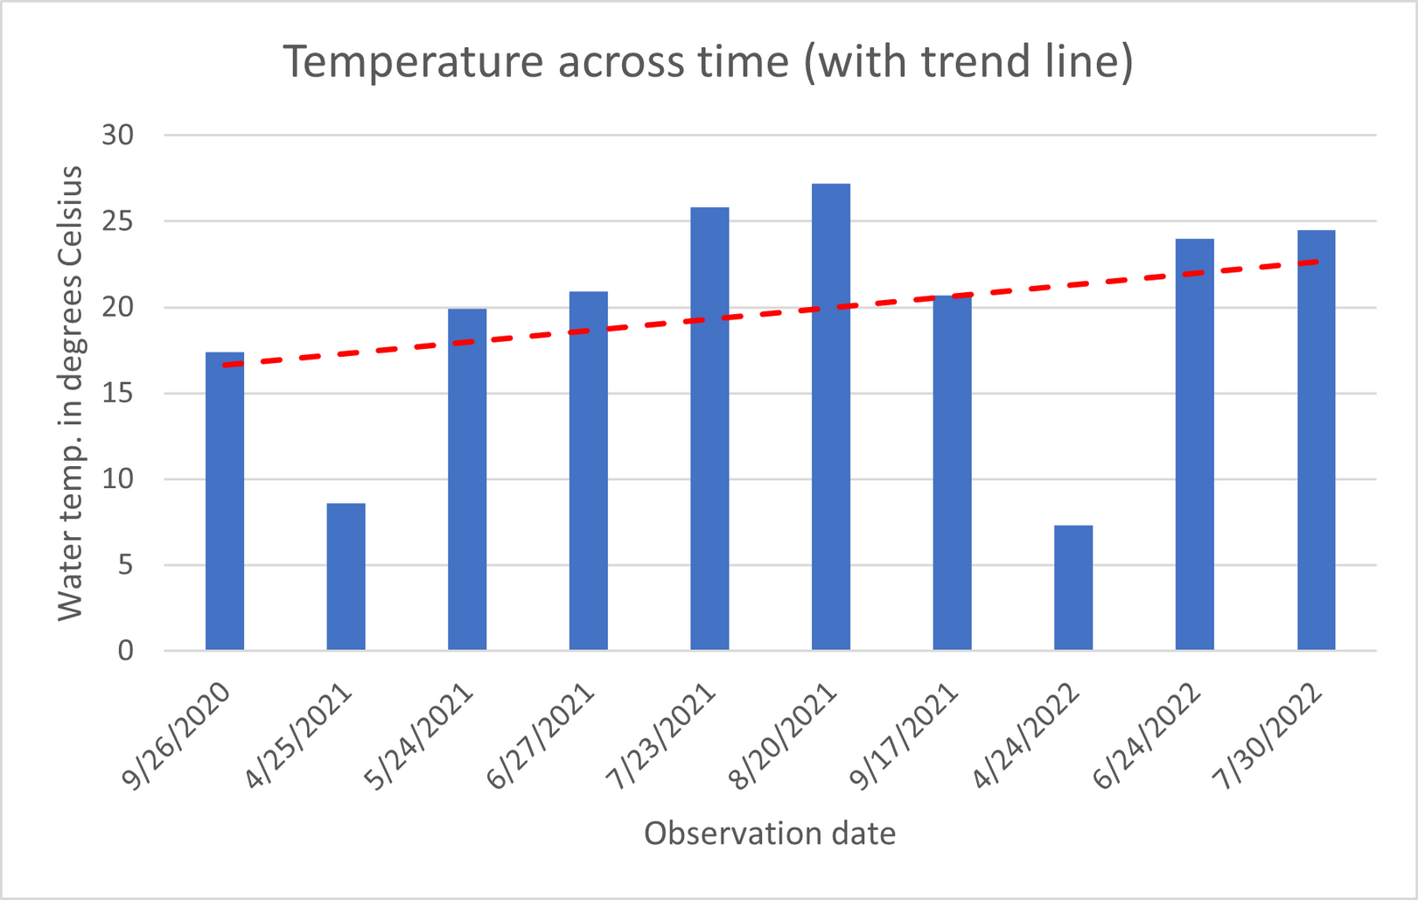
Part 5: Building our own graph
Answer key
Notes:
Note the trend line (which students didn't have to draw) - ask students what they see is changing over time.
In the short span of two years, we are seeing a large increase in water temperature change.

Slide 27
Table 2: Water temperature °C 2019-2022
Part 5: Building our own graph
Observation date | Water temperature
5/24/2019 | 13.3
6/24/2019 | 21.6
7/24/2019 | 25.9
8/25/2019 | 22.6
9/24/2019 | 19.2
5/24/2020 | 16.0
6/26/2020 | 21.1
7/26/2020 | 26.2
8/31/2020 | 22.4
9/26/2020 | 17.5
5/24/2021 | 18.9
6/27/2021 | 19.8
7/23/2021 | 25.5
8/20/2021 | 27.3
9/17/2021 | 21.0
5/29/2022 | 19.1
6/25/2022 | 24.0
7/31/2022 | 24.5
Extension activity:
Based on the information in Table 2, make a histogram of water temperature at Sharbot Lake (West basin) from 2019 to 2022.
You need to set an appropriate number of intervals, make a frequency distribution table using these intervals, then make a graph with the intervals on the x axis and frequency on the y axis.
Don’t forget to label your axes!

Slide 28
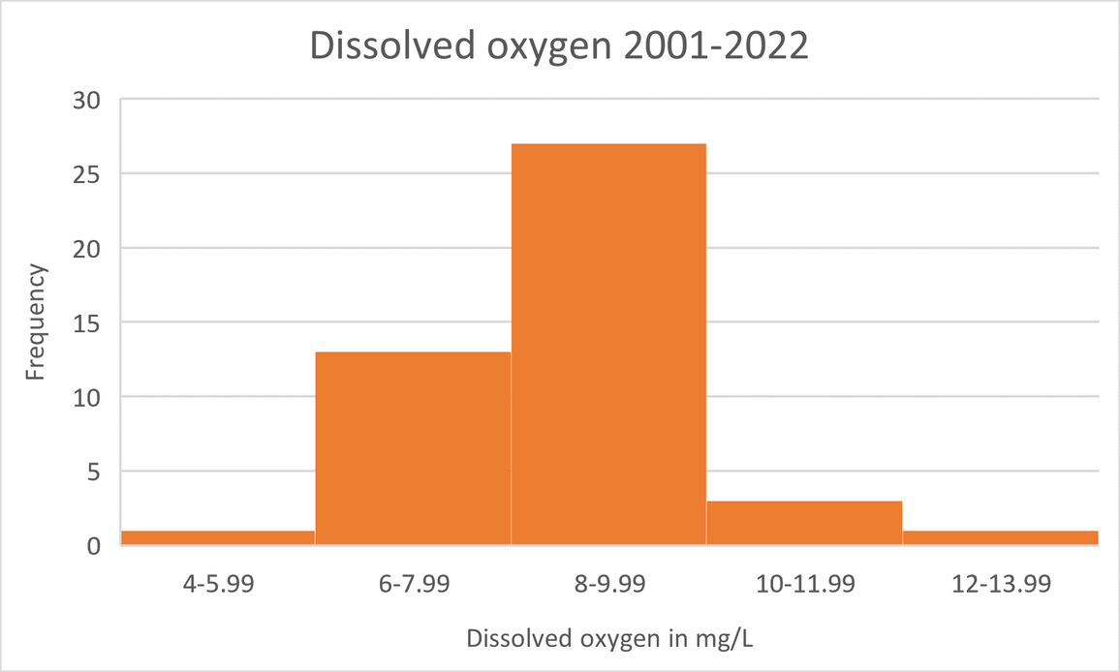
Part 5: Building our own graph
Table 3: Frequency distribution table Dissolved oxygen 2001-2022
Extension activity:
To give you an example, here is a histogram made with observations of dissolved oxygen:
Value | Frequency
4-5.99 | 1
6-7.99 | 13
8-9.99 | 27
10-11.99 | 3
12-13.99 | 1
Notes:
It may be worthwhile asking students about why histograms are important, and what they help us see more clearly from data.
In this case, the histogram for dissolved oxygen from 2011-2022 helps us see the most common values taken - these are the normal values, and likely healthy values, too!

Slide 29
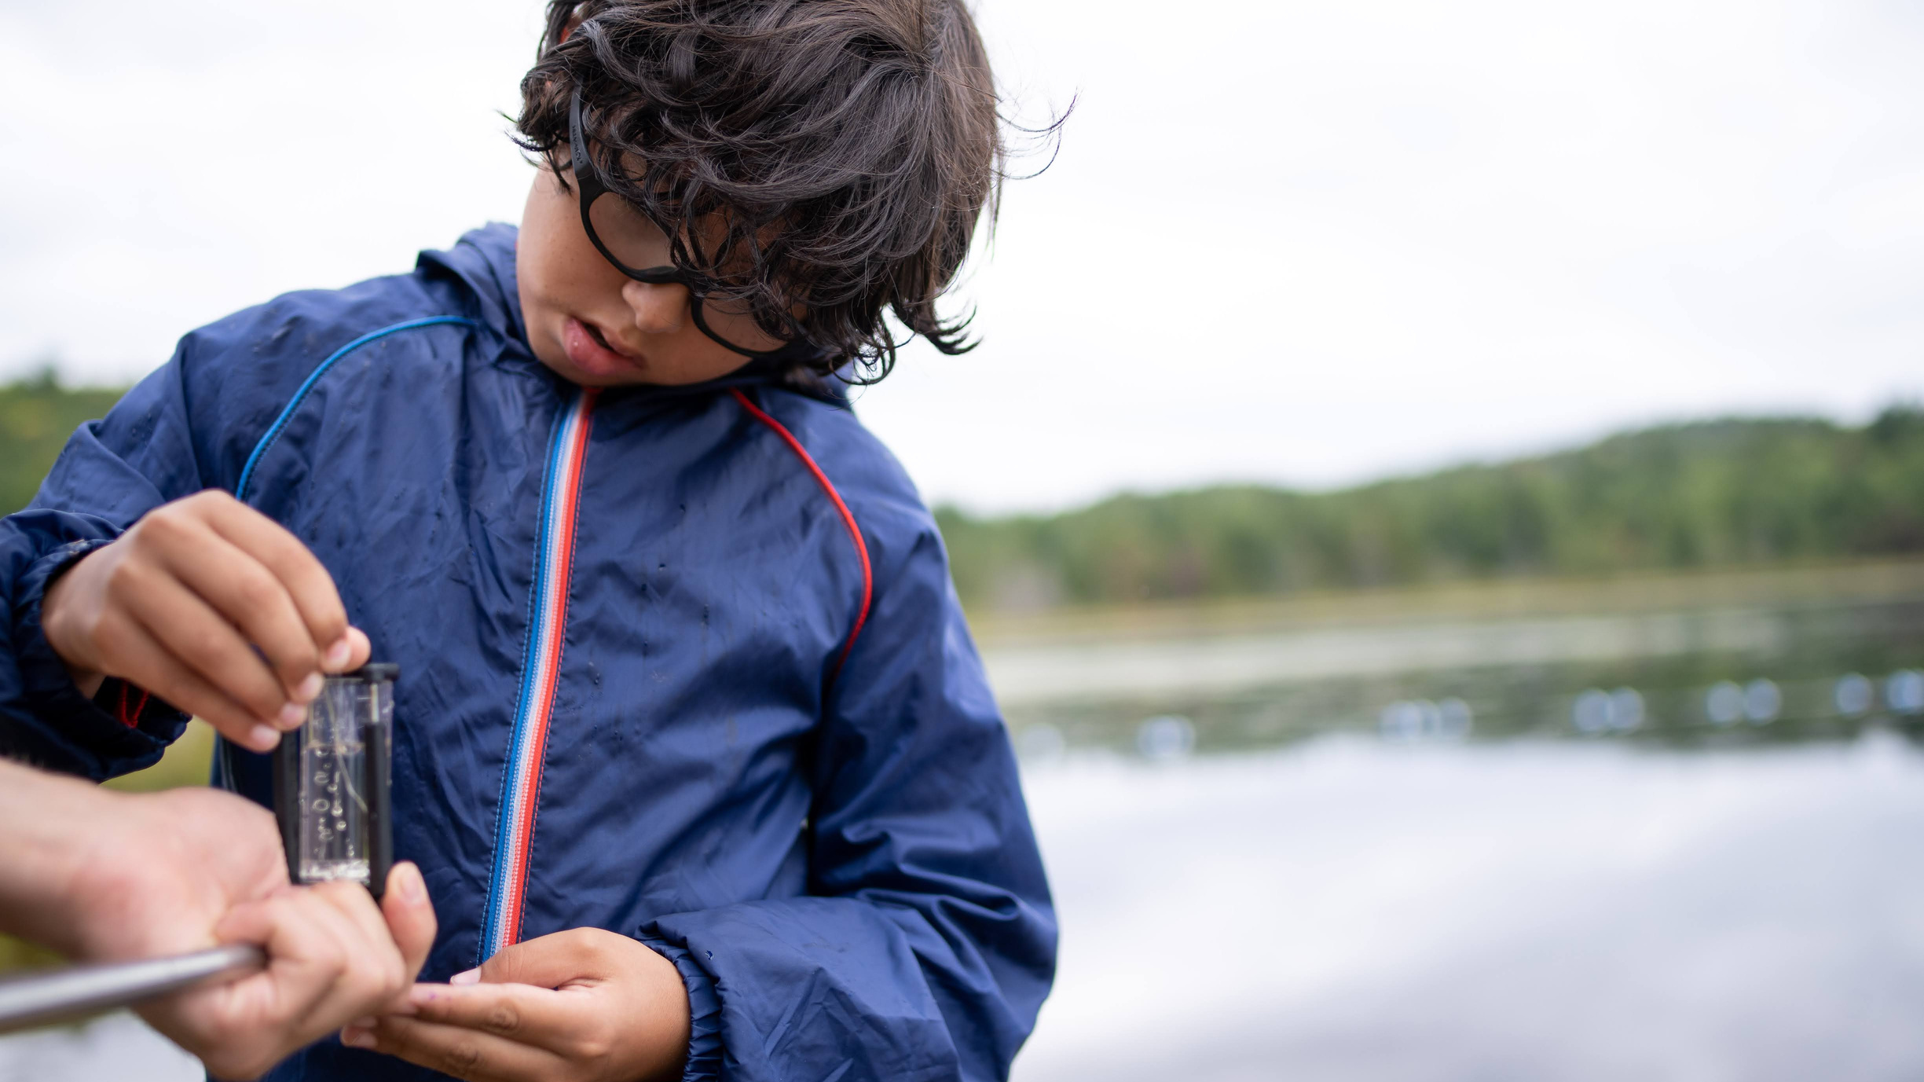
What have we learned?

Slide 30
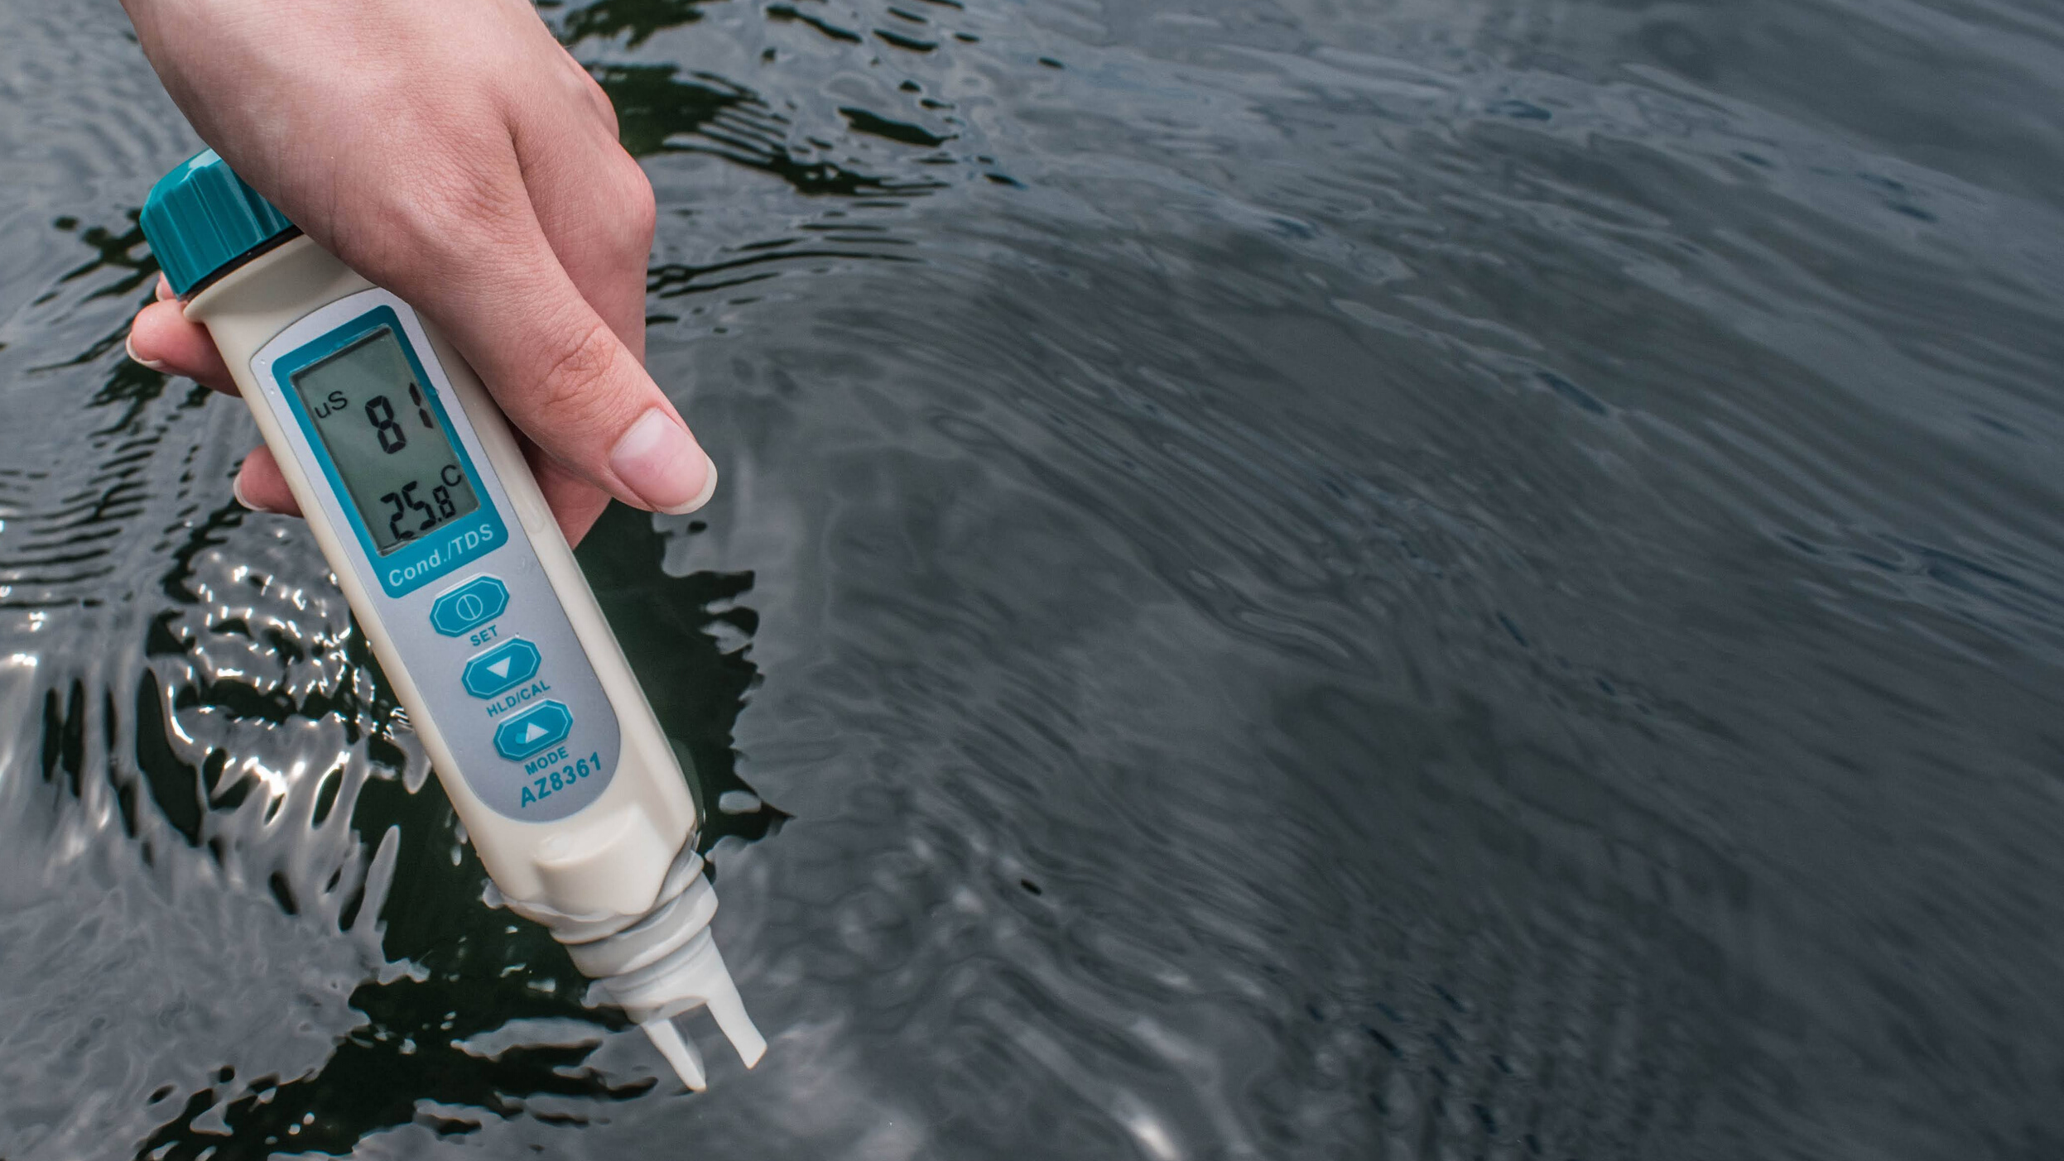
Key takeaways
  There are real issues facing water bodies in Canada.
  Warming temperatures leading to drops in oxygen.
  Water data gathered by individuals can lead to change. This is called community science. (All the activities were based upon the work of community scientists in Canada!)
  You can take action to promote positive change!
What did you learn? Share your thoughts on social media tagging #waterrangers!
Notes:
Make it clear that there is a real issue facing water in Canada: warming temperatures leading to drops in oxygen. Also highlight that there are things we can do to alleviate this, such as taking action to promote positive change.
Highlight how citizen/community science gathered by individuals can lead to change. All the activities of the series were based upon the work of citizen science.
Start a testing group here: https://waterrangers.ca/act/groups/
Visit our training page with resources for educators here: https://waterrangers.ca/act/educators/

Slide 31

Thanks for participating!
A special thanks to Guy McLeod and Mississippi Valley Conservation Authority for diligently collecting and sharing water quality data on Sharbot lake. View the data here.
Thank you to NSERC Science Literacy Week for making this project possible.

