Slide 1
Community science with Water Rangers!

Slide 2
How many lakes, rivers, and streams are there in Canada?
Over 2 million!
Canada boasts the longest coastline in the world
Canada is the 4th country in the world with the largest freshwater reserve; Brazil, Russia, US, Canada
75% of watersheds are data deficient
That’s where you come in! And community science.
Source: 2025 Watershed Reports

Slide 3
Water Rangers builds easy to use tools to collect water quality data.
Community science is when everyday people work together to collect data and solve problems in their environment.
We are going to be community scientists and test a local water body!
What do you know about the water in your community?
Notes:
Community science is when everyday people work together to collect data and solve problems in their environment. It helps scientists and communities better understand and protect nature's gifts, like water.

Slide 4
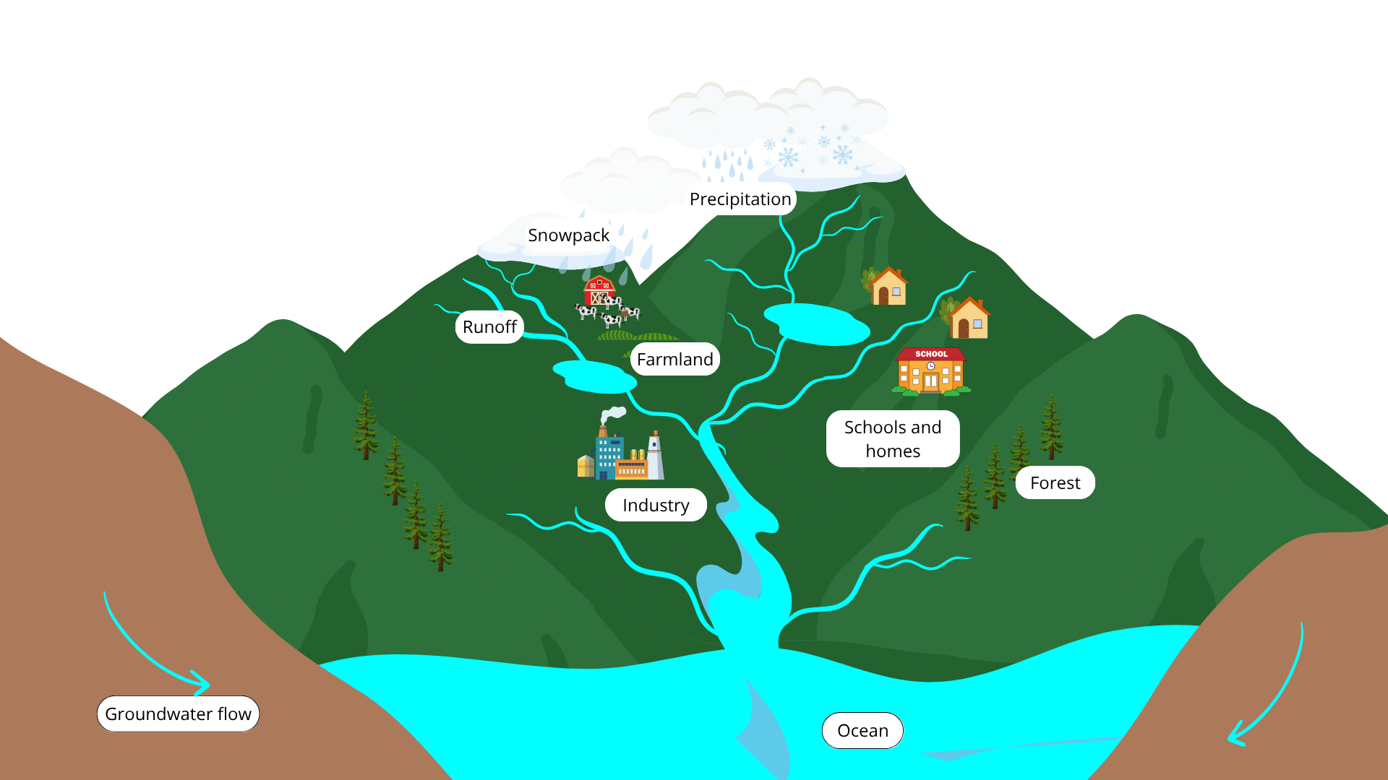
Did you know?
What is a watershed?
Canada has 11 major watersheds and 164
sub-watersheds, with five basins that flow into the ocean: the Pacific, Arctic, Hudson Bay, Atlantic, and Gulf of Mexico.
A watershed is an area of land that collects precipitation and drains it through a network of streams and rivers into a common body of water. Every place on land is part of a watershed, and so your actions affect more than just your immediate surroundings: water problems flow, and most eventually end up in the ocean.
Flowing where?
Understanding how you fit in your watershed helps you better understand your impacts. What’s upstream? What’s downstream?
Notes:
You can think of a watershed like a shower. Water may splash on the wall, or on the side of the tub, but it will all eventually flow into the drain.

Slide 5
Qualitative observations
Observations you make with your senses.
Weather: What was the weather like the day before and day of?
On the surface: Is there anything floating in the water?
Pollution sources: Depending on land use, there may be different sources.
Evidence of water use: How do people interact with the water?
Algae: Are there green mats, stringy growth, or scummy patches on the surface?
Water flow: Is the water moving or still?
Water level: Is the water unusually high or low?
Water colour: Water colour can reveal sediment levels, organic matter, or even algae.
Odour: Does it smell fresh, earthy, or unpleasant?

Slide 6
Quantitative observations
Observations that use tools to take measurements and record numbers.
With Water Rangers' tools, we can test for several parameters.
A parameter is a measurable factor that helps us figure out if the water that we test for is healthy or not.
Simple tools provide important information! Qualitative observations helps us understand quantitative observations.

Slide 7
Air and water temperature
Air temperature and water temperature influence other parameters we test for. They help us observe seasonal changes!
Water temperature also impacts the bodily function of aquatic organisms.

Slide 8
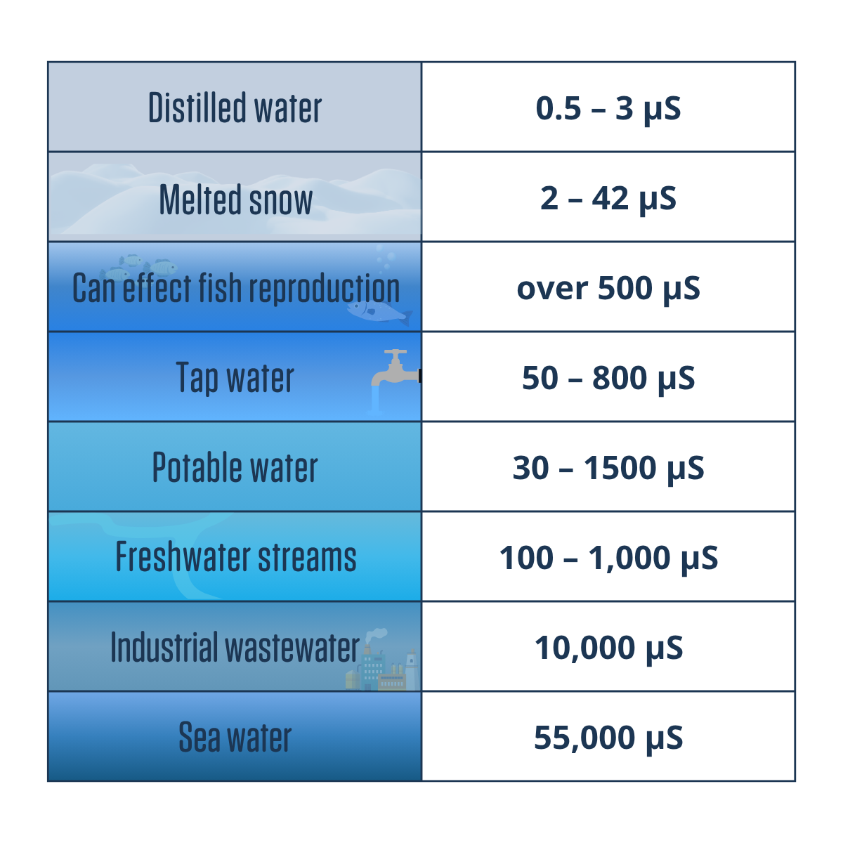
Conductivity
What is it?
Water’s ability to conduct electricity and measures its ionic content (e.g. chloride, nitrate, sodium, magnesium, calcium, or iron).
Why is it important?
Every body of water has its own unique conductivity level, based on its bedrock.
What do the measurements mean?
It’s important to establish a baseline when water testing. We can use conductivity as an early warning system for potential problems that warrant further testing.

Slide 9
Salinity
What is it?
The amount of dissolved salt in water from natural sources like rocks and soil.
Why is it important?
Along with temperature, it influences water density, which drives currents, nutrient mixing, and the distribution of heat and oxygen.
Some quick ranges
Freshwater
0 - 0.5 ppt
Brackish water
0.5 - 0.31 ppt
Ocean
31 - 35 ppt

Slide 10
Salinity vs. Conductivity
Salinity
Conductivity
Total concentration of dissolved salts in water. | Total concentration of dissolved ions in water.
Measured in parts per thousand (ppt). If there is a decimal, its parts per million (ppm). | Measured in microseimens per cm (uS/cm). If there is a decimal, its milliseimens (mS/cm).
A key factor in oceanography, influencing density, mixing, and ocean circulation. | Can indicate pollution or changes in water quality, and hint at the water’s source based on its natural conductivity level.
Can come from eroded rocks on land, openings in the seafloor, and runoff. Often lower than the 35ppm ocean average due to mixing with rivers and streams. | Can come from minerals in bedrock, soil and sediment erosion, runoff, as well as human activities such as agriculture, industry, and wastewater discharge.
What is it?
Units
Why is it important?
Where does it come from?

Slide 11
Nitrates
How to interpret:
A specific form of nitrogen that is formed after nitrites have been exposed to nitrifying bacteria. Nitrates (NO ) are bioavailable, meaning they are an important source of nutrients for plants.
Why is it important? Algae and other aquatic plants use nitrates as a vital source of food. However, excess levels of nitrates in water can make it difficult for aquatic insects or fish to survive.
Strips usually read 0 since they aren’t sensitive enough for small amounts
Natural levels are under 1 ppm
Above 10 ppm can harm aquatic life
10 ppm is the legal limit for drinking water
Sensitive fish prefer under 0.06 ppm
3
Notes:
Community science is when everyday people work together to collect data and solve problems in their environment. It helps scientists and communities better understand and protect nature's gifts, like water.

Slide 12
Nitrites
A compound that forms naturally when nitrogen combines with oxygen. It consists of one nitrogen atom and two oxygen atoms. Nitrite can be oxidized into nitrate, becoming less toxic.
Why is it important? Algae and other aquatic plants use nitrates as a vital source of food. However, excess levels of nitrates in water can make it difficult for aquatic insects or fish to survive.
How to interpret:
Strips usually read 0 since they aren’t sensitive enough for small amounts
It is natural to have some in water
Over 1 ppm is considered dangerous
Too much causes plant growth that lowers oxygen and harms fish
Notes:
Community science is when everyday people work together to collect data and solve problems in their environment. It helps scientists and communities better understand and protect nature's gifts, like water.

Slide 13
Chlorine
A reactive gas not found freely in nature that is used to disinfect water. Testing helps detect unexpected pollution sources into a water body, like pool discharge or nearby treatment plants.
How to interpret:
0-0.5 ppm: Great
1 ppm: Worrying
2+ ppm: Is this a pool?
Notes:
Community science is when everyday people work together to collect data and solve problems in their environment. It helps scientists and communities better understand and protect nature's gifts, like water.

Slide 14
pH
What is it?
pH, short for “potential of hydrogen”, is the measure of the acidity or alkalinity of water.
Why is it important?
pH influences how easily nutrients are available and how easily pollutants dissolve in water. Aquatic life is sensitive to pH changes.
What do the measurements mean?
Low pH levels can harm fish gills and reproduction, and dissolve the shells of animals like sea urchins, coral, and sea snails.

Slide 15
Alkalinity
Water’s ability to neutralize acid and resist pH changes, influenced by soil, bedrock, plants, and industrial waste. High levels are NOT a sign of bad water quality. Alkalinity (and hardness) helps determine which guidelines apply when testing for heavy metals.
How to interpret:
10 ppm: Very low
11-50 ppm: Low
51-150 ppm: Moderate 151-300 ppm: High
> 300 ppm: Very high
Notes:
Community science is when everyday people work together to collect data and solve problems in their environment. It helps scientists and communities better understand and protect nature's gifts, like water.

Slide 16
Hardness
Related to alkalinity (they often change together) as both involve calcium carbonate, but hardness also measures other dissolved minerals like calcium and magnesium that don't necessarily neutralize acid.
How to interpret:
0-20 ppm: Soft
21-60 ppm: Moderately soft
61-120 ppm: Moderately hard
121-180 ppm: Hard
>180 ppm: Very hard
Notes:
Community science is when everyday people work together to collect data and solve problems in their environment. It helps scientists and communities better understand and protect nature's gifts, like water.

Slide 17
Dissolved oxygen
What is it?
What do the measurements mean?
The amount of gaseous oxygen dissolved in the water.
Affected by flow, temperature, and depth. Cold, shallow, and moving water holds more oxygen. Plants add oxygen, but too much plant or algal growth can lead to organic decay, which uses up oxygen.
Why is it important?
Oxygen is what gives the water life! All living things in an aquatic ecosystem need oxygen to survive.
0 mg/L
2 mg/L
4 mg/L
7 mg/l
11+ mg/L
Not enough oxygen to support life
Few fish and aquatic insects can live
Good for many aquatic animals, low for cold water and some small fish
Very good for most stream fish
Notes:
How does oxygen get into the water?
Oxygen gets into the water through the air, rapidly moving water, and photosynthesis.

Slide 18
You’re part of the team now!
Water Rangers are:
Wide-eyed & optimistic: Open and positive about the work ahead.
Boundlessly curious: Lifelong learners with inquiring minds.
Better together: Working with each other to reach our goals.
Head & heart strong: Stepping up to do what needs to be done.
Forward thinkers: Imagining a better world together.
Let’s head to the field and get testing!
Find out more ways you can join the movement at waterrangers.com/join-the-wave

Slide 19
Thanks for being a part of our community!
@the_waterrangers
waterrangers.com
Water Rangers
contact@waterrangers.ca
@water_rangers

